Slide 1
SPARE PART SYSTEM
Project Improvement
Feb 2023
BSS
PF
Prepared By
Checked By
Prepared By
Checked By

Slide 2
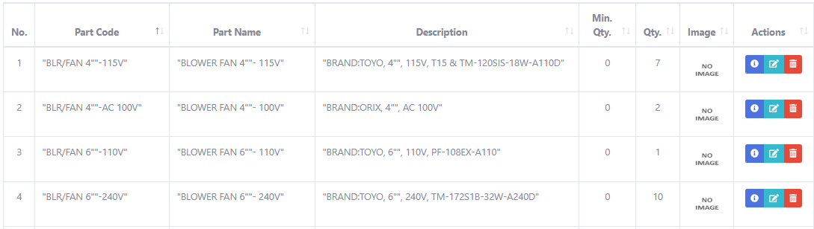
Project Improvement (1/9)
Function ‘Min Qty’ value will be added.

Slide 3
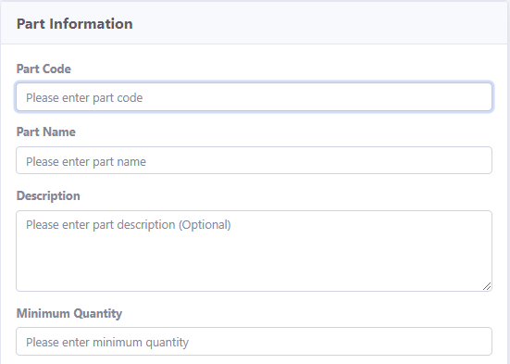
Project Improvement (2/9)
Only Administrator user are allowed to Add the ‘Min Qty’.

Slide 4
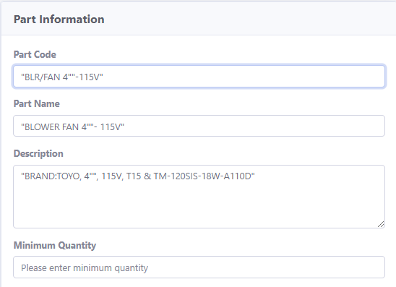
Project Improvement (3/9)
Only Administrator user are allowed to update the ‘Min Qty’.

Slide 5
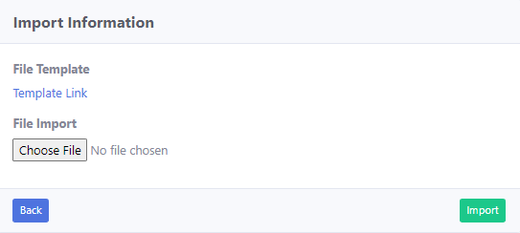
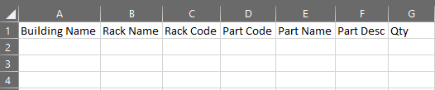
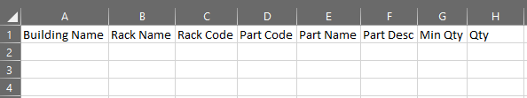
Project Improvement (4/9)
Excel file template will have ‘Min Qty’ value added.
Old Excel file template
New Excel file template

Slide 6
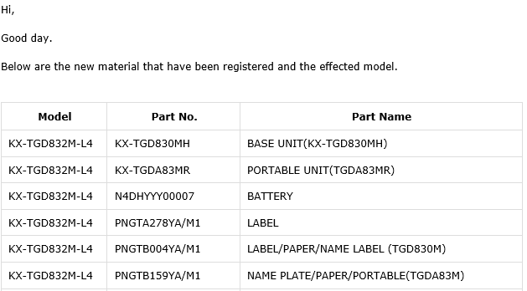
Project Improvement (5/9)
Send email to administrator if the parts ‘min qty’ value has reached or below the ‘min qty’ value.
One email will be sent to administrator user per week.
Send email data will be in list of part summary.
Include Part Qty.
and Min. Qty.
Min. Qty.
Part Qty.

Slide 7
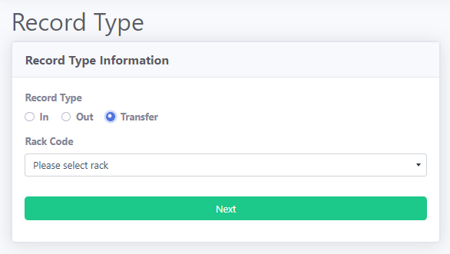

Project Improvement (6/9)
Add function ‘Transfer’ for record purpose.

Slide 8
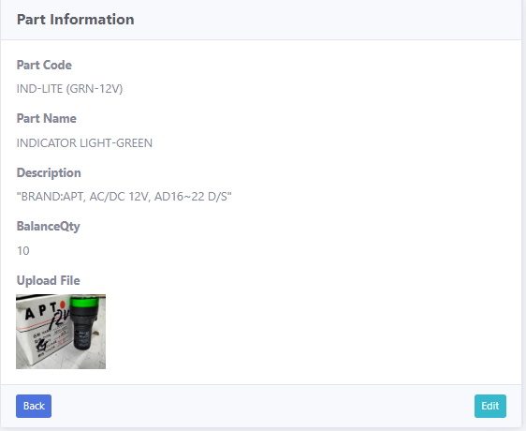
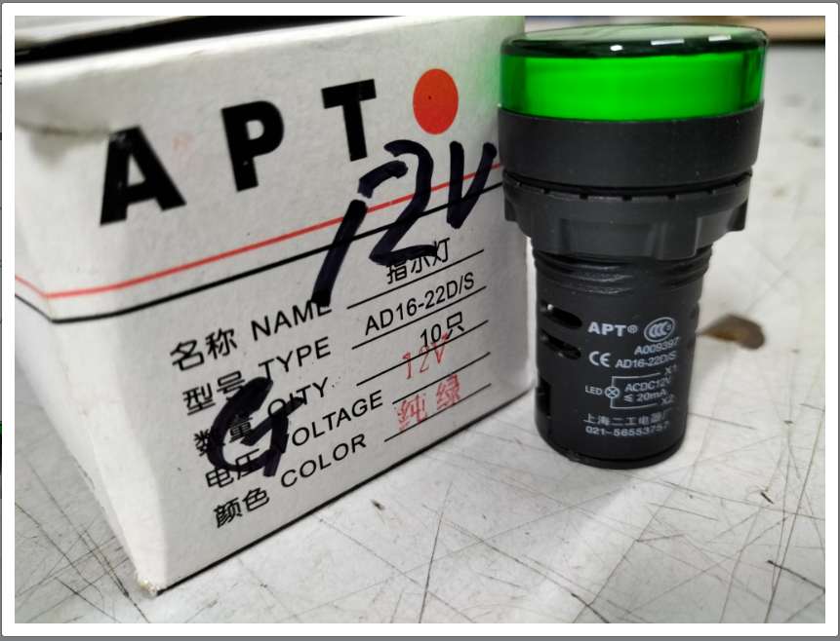
Project Improvement (7/9)
Allow user to enlarge the selected image when clicked.

Slide 9

Project Improvement (8/9)
Add ‘Image not found’, photo for not found image.

Slide 10
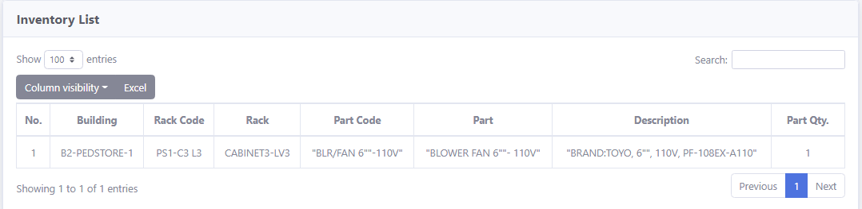
Project Improvement (9/9)
Add ‘Min Qty’ to inventory report.
Min. Qty.

